Slide 1


Slide 2
03 – WHY OUR APP IS NEEDED

Slide 3

04 – DATA SOURCES

Slide 4
05 – THE PROBLEM

Slide 5
06 – HEALTH IMPACTS

Slide 6
07 – PARTNERSHIPS

Slide 7
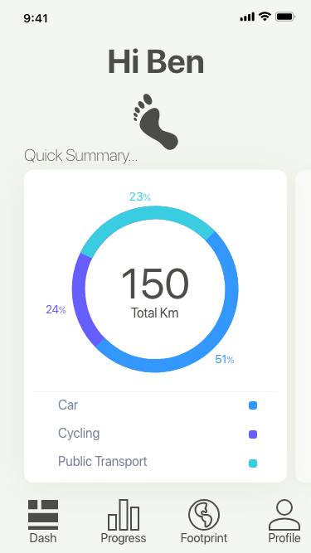
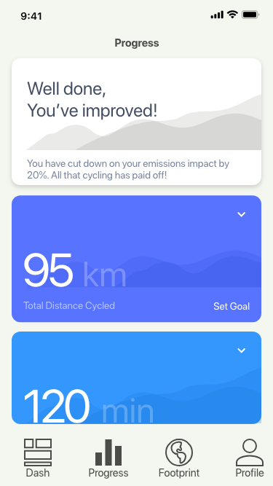
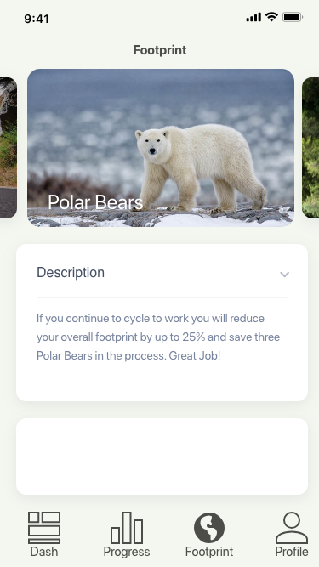
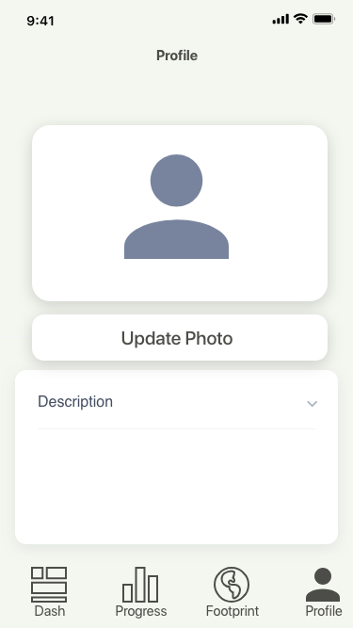
08 – DESIGN

Slide 8
ANY QUESTIONS?

